Slide 1
Chapter 10. Bipolar junction transistor fundamentals
Invented in 1948 by Bardeen, Brattain and Shockley
Contains three adjoining, alternately doped semiconductor regions: Emitter (E), Base (B), and Collector (C)
The middle region, base, is very thin compared to the diffusion length of minority carriers
Two kinds: npn and pnp

Slide 2
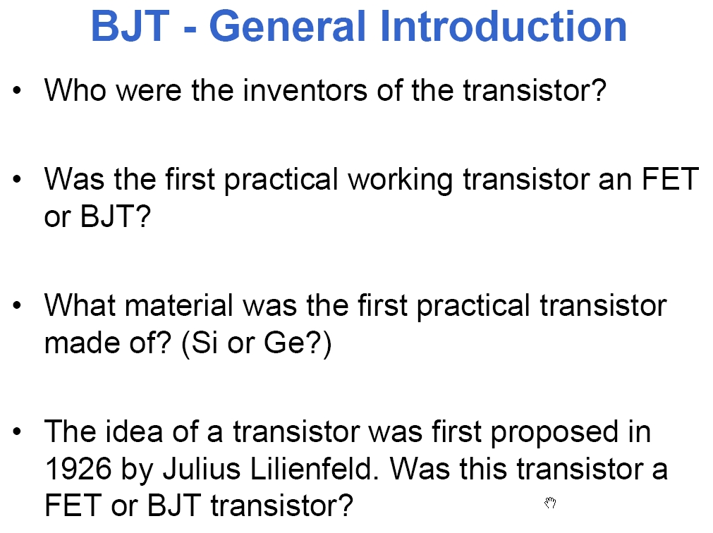

Slide 3
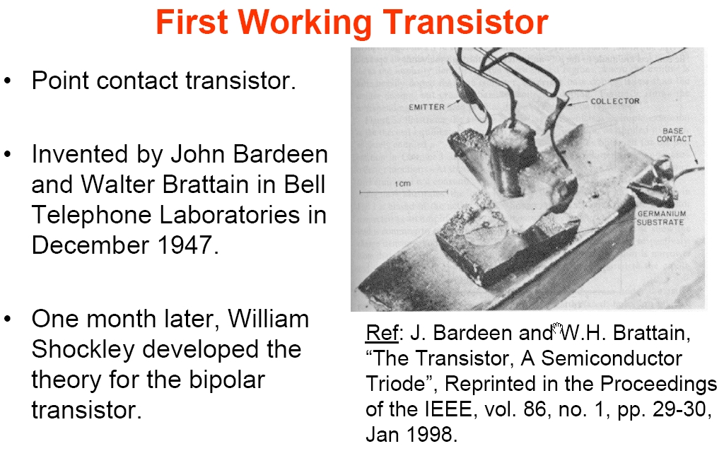

Slide 4
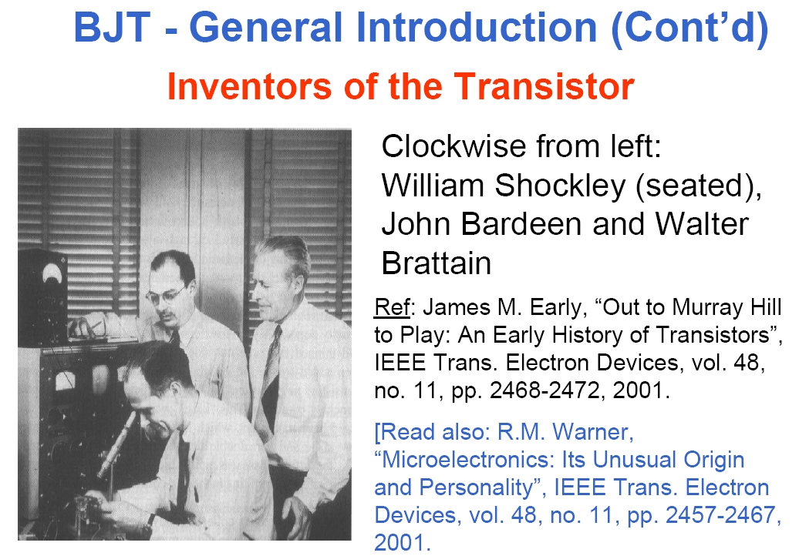

Slide 5
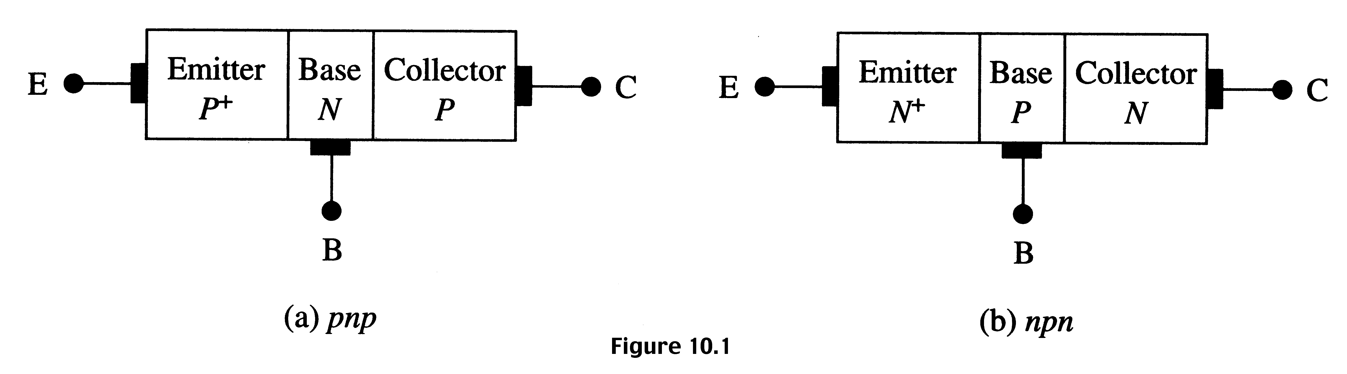
Schematic representation of pnp and npn BJTs
Emitter is heavily doped compared to collector. So, emitter
and collector are not interchangeable.
The base width is small compared to the minority carrier
diffusion length. If the base is much larger, then this will
behave like back-to-back diodes.

Slide 6
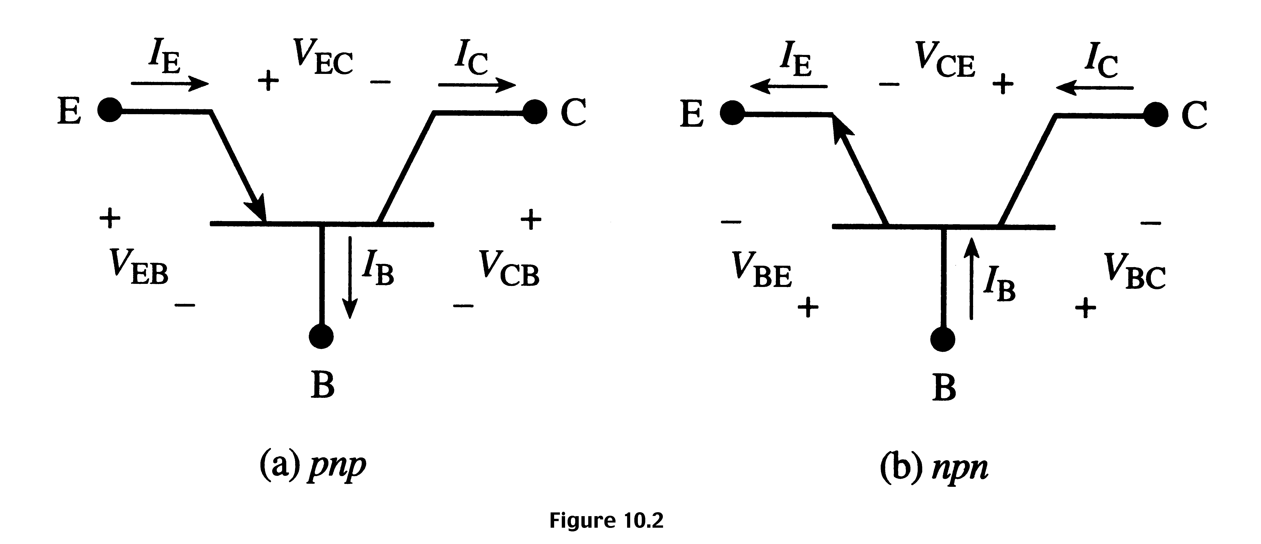
BJT circuit symbols
I_{E} = I_{B} + I_{C} and V_{EB} + V_{BC} + V_{CE} = 0 V_{CE} = − V_{EC}
As shown, the currents are positive quantities when the
transistor is operated in forward active mode.

Slide 7
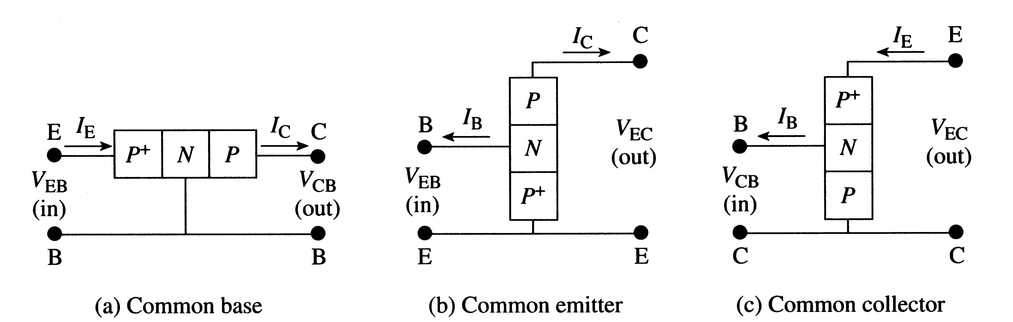
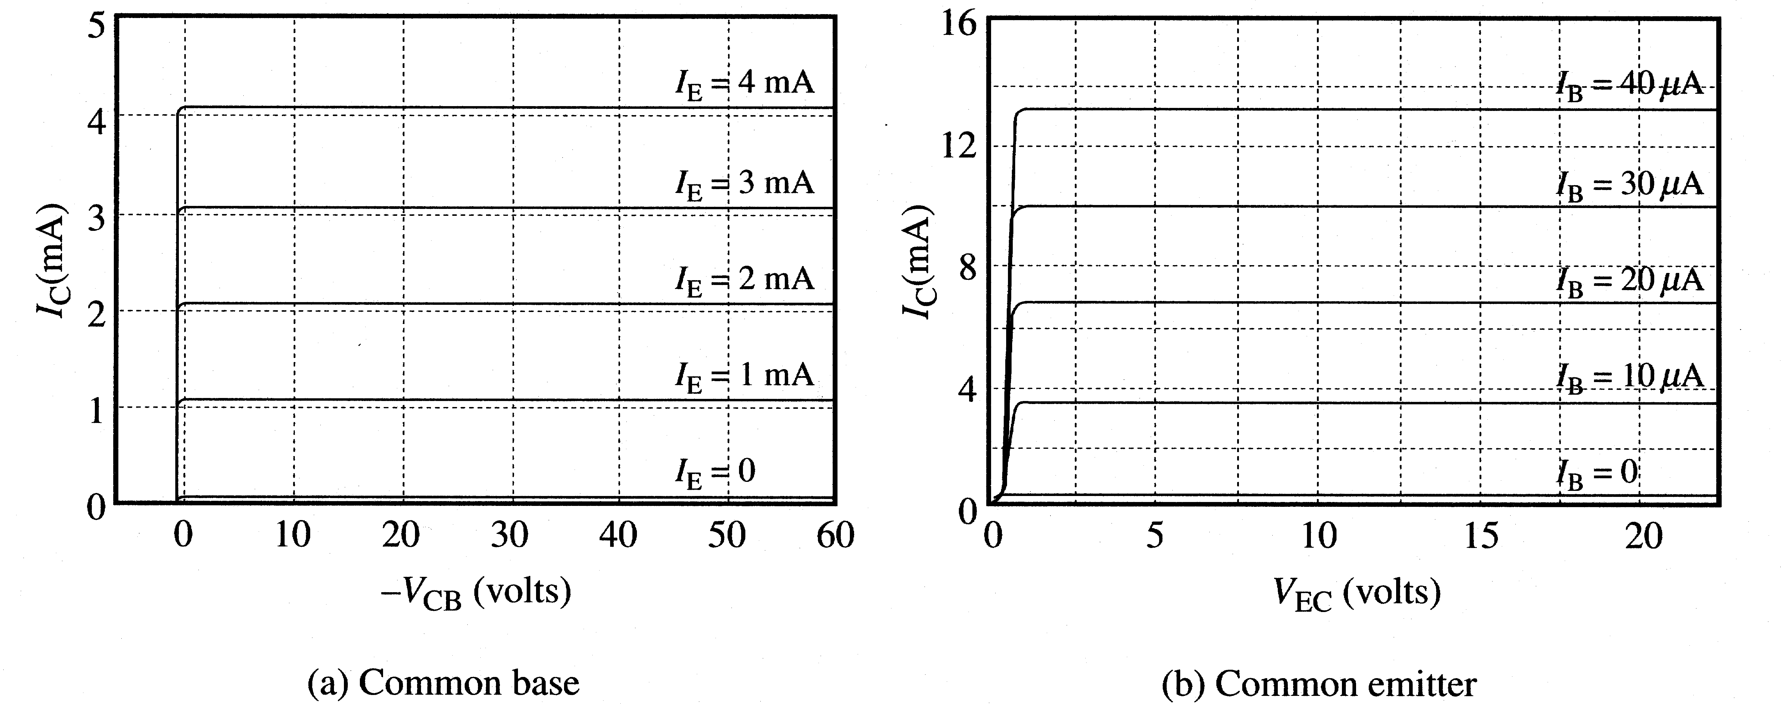
BJT circuit configurations and output characteristics

Slide 8
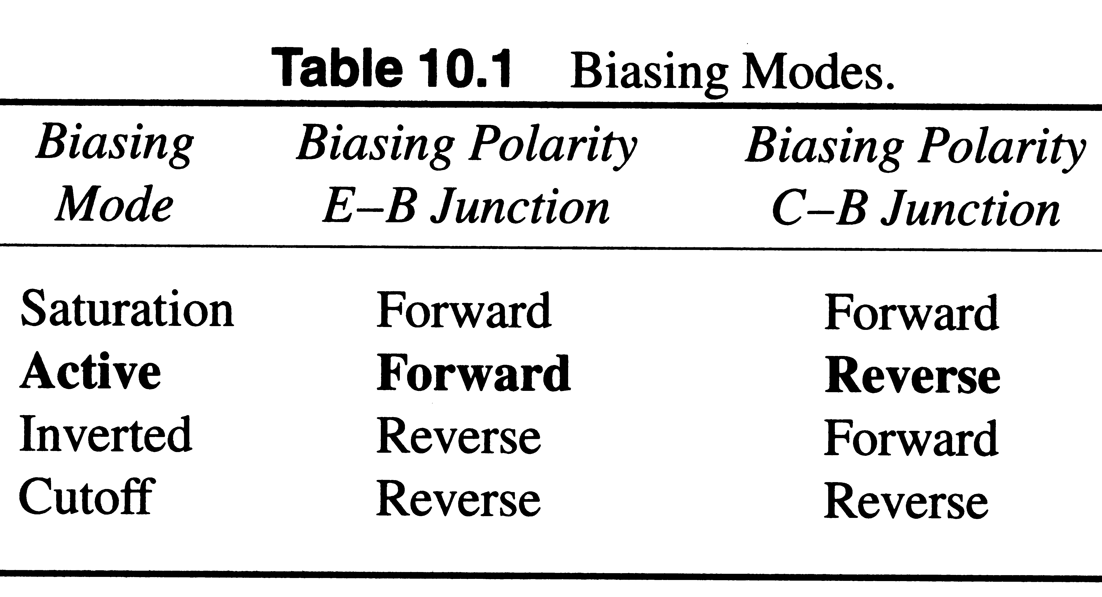
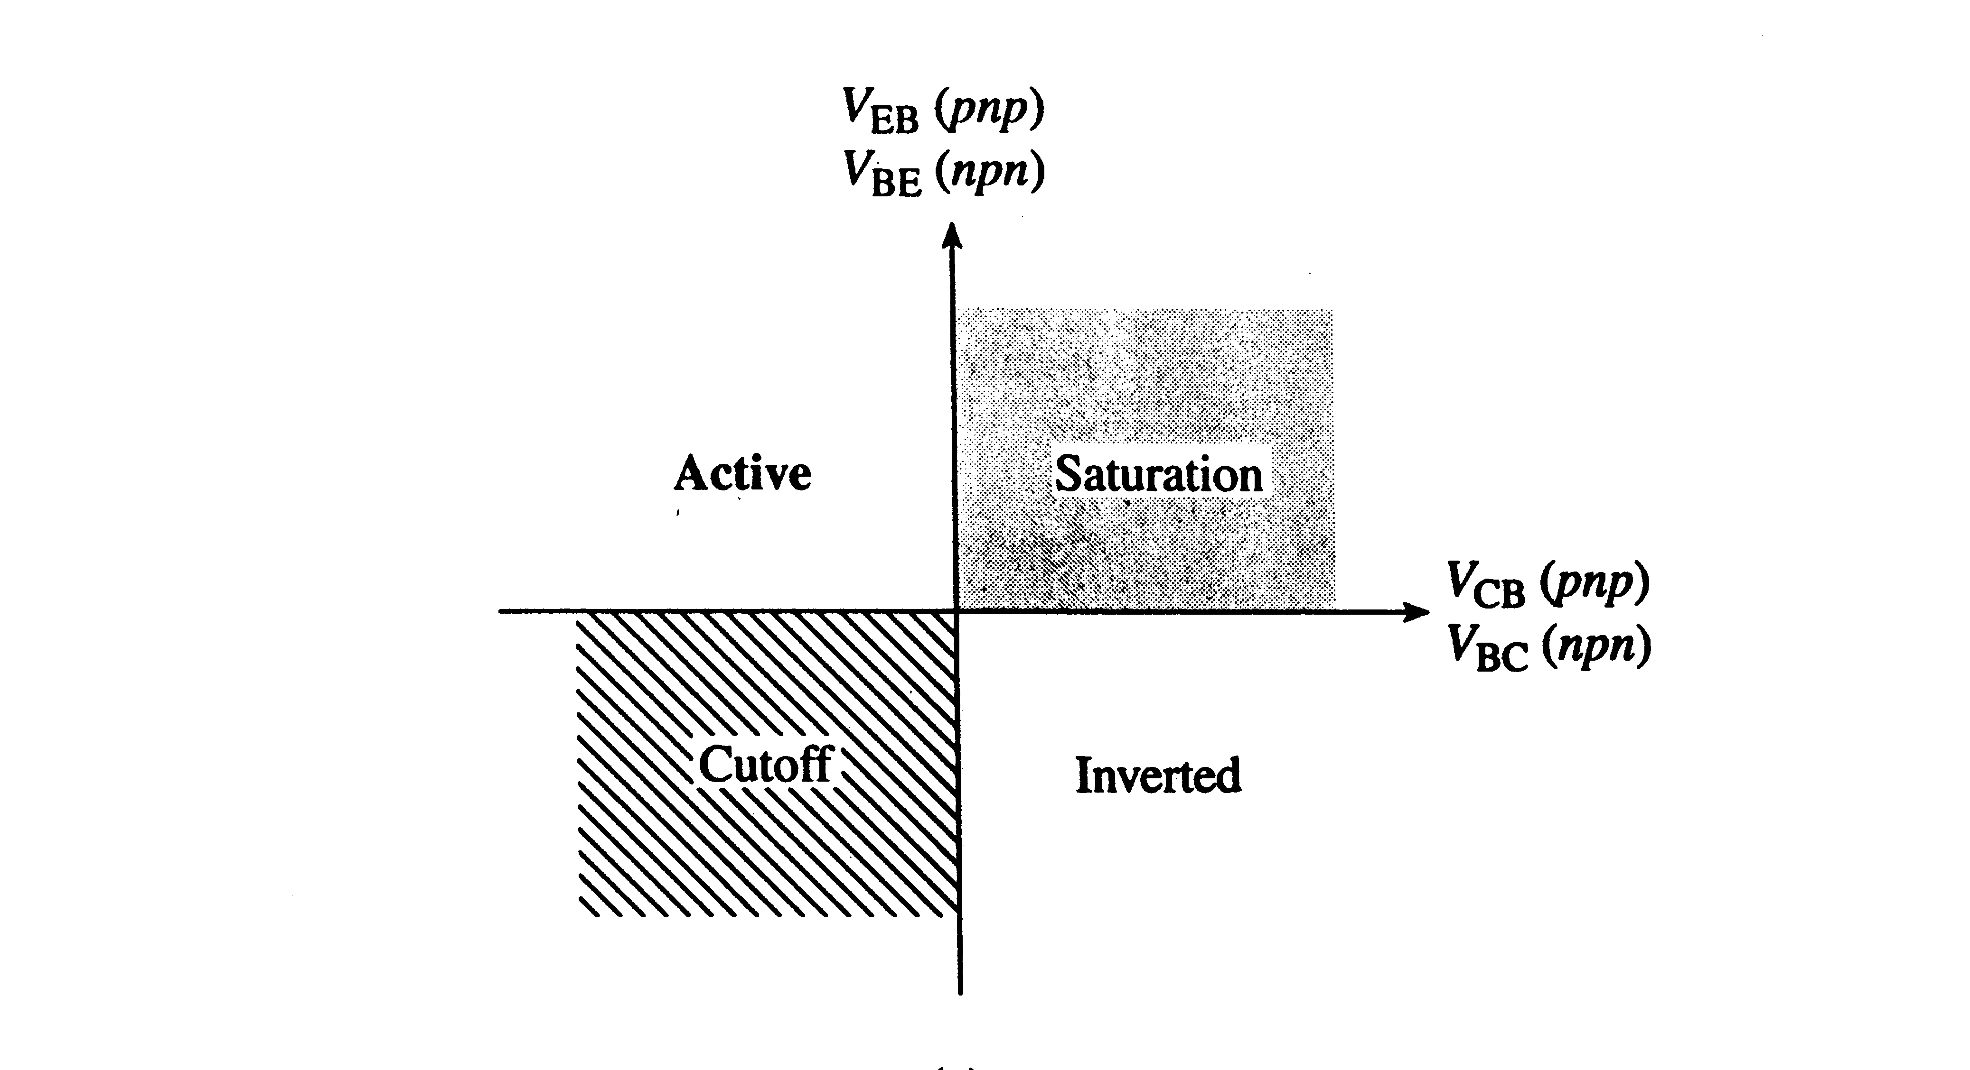
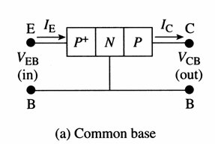
BJT biasing modes

Slide 9
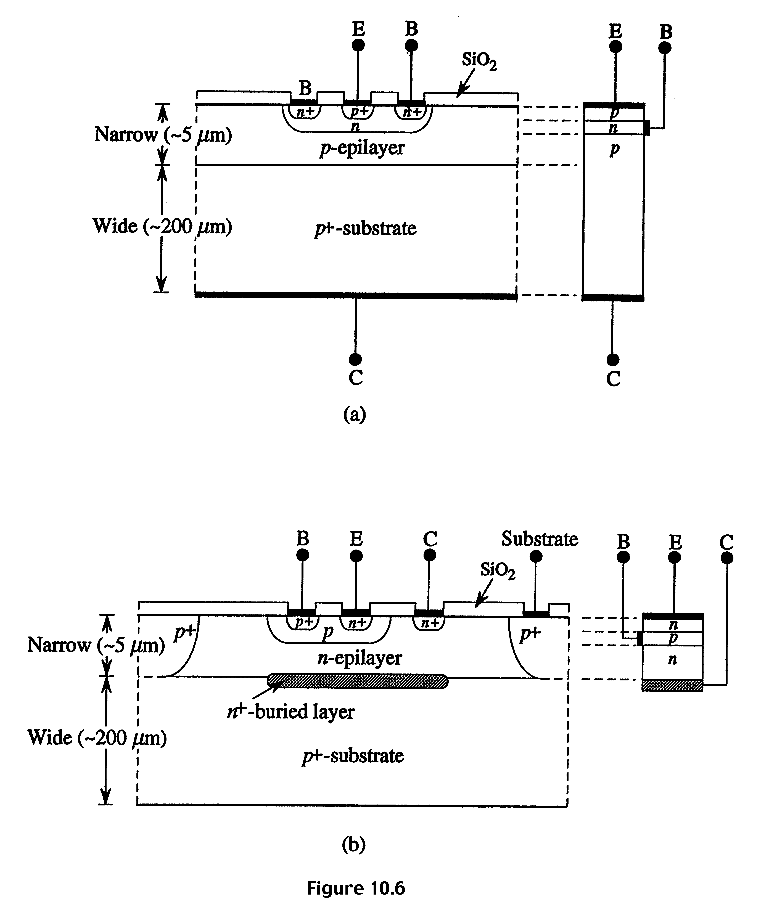
Cross sections and simplified models of discrete and IC npn BJTs

Slide 10
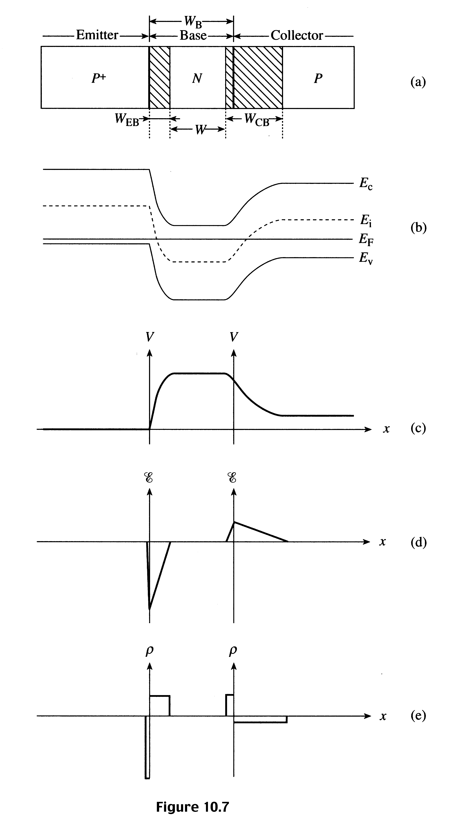
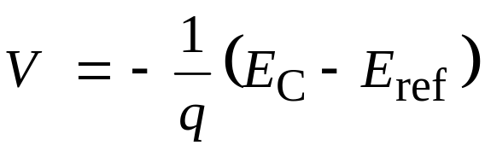
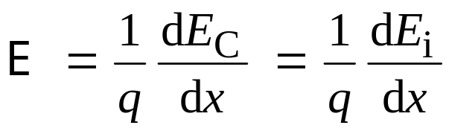
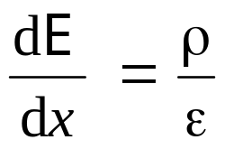
Electrostatic variables for a pnp BJT at equilibrium
ρ = charge density
ε = K_{s} ε_{o}

Slide 11






Qualitative discussions of operation
Consider two diodes, one forward biased and one reverse biased.
reverse
forward

Slide 12





Qualitative discussion of transistor action
Combine the two diodes!
V_{F}
V_{R}
No transistor action

Slide 13




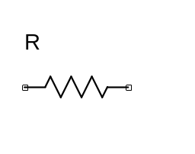
Consider very thin base width: Transistor action
E(P⁺) B(N) C(P)
Hole concentration is zero here, reverse biased
V_{F}
V_{R}
The collector current I_{C} is almost equal to I_{E}, and collector current
is controlled by the E-B junction bias. The loss, i.e. α < 1
corresponds to the recombination of holes in base.

Slide 14











PNP under forward active mode
P N P
I_{EP}
I_{BR}
–I_{EN}
–I_{BE}
–I_{BR}
Electron
flux
E B C
Hole
flux
and current
I_{E} = I_{EP} + I_{EN} = 1 + 2 + 5
I_{B} = I_{BR} + I_{BE} = I_{BR} + I_{EN} = – (4 + 5)
I_{C} = I_{EP} – I_{BR} = 2

Slide 15
Current components
1 = hole current lost due to recombination in base, I_{BR}
2 = hole current collected by collector, ~ I_{C}
1 + 2 = hole part of emitter current, I_{EP}
5 = electrons injected across forward biased E-B junction, (– I_{BE});
same as electron part of emitter current, – I_{EN}
4 = electron supplied by base contact for recombination with
holes lost, – I_{BR} (= 1)
3 = thermally generated e & h making up reverse saturation
current of reverse biased C-B junction. (generally neglected)

Slide 16
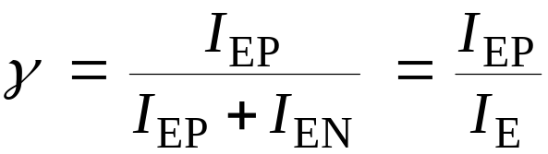
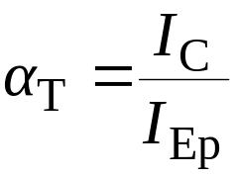


Performance parameters (Consider pnp)
Neglect the reverse leakage (electron) current of C-B junction
Emitter efficiency:
Fraction of emitter current carried by holes.
We want γ close to 1.
Base transport factor:
Fraction of holes collected by the collector.
We want α_{T} close to 1.
Common base dc current gain:
Note that α is less than 1.0 but close to 1.0 (e.g. α = 0.99)

Slide 17

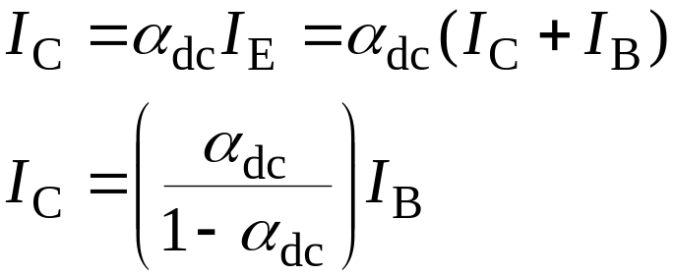
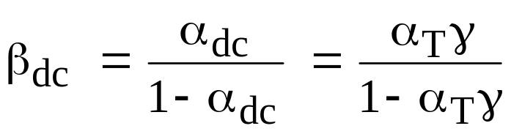
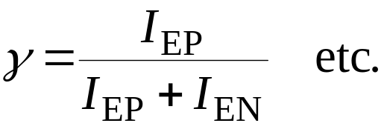
Performance parameters (Consider pnp)
Common emitter dc current gain, β_{dc}:
But,
Note that β is large (e.g. β = 100)
For npn transistor, similar analysis can be carried out. However,
the emitter current is mainly carried by electrons.
Example:

